Slide 1

Kontizas Team
Galanos Vasilis
Kyrkos kostas
Mouselinos spyros
Mpaltzi sofia
Saltos thomas

Slide 2
Overview
Part I
Reinforcement Learning Applications on Recommender Systems
Part II
Federated Learning Applications on Recommender Systems
Data Manipulation
Evaluation metrics
Methods - Experiments
Environment
Data manipulation
Problem statement
Metrics
Federated Avg
Notes:
Όποιος παρουσιάσει αυτό το κομμάτι μπορεί να πει ότι πρώτα θα ασχοληθούμε με το Part I και θα πούμε τα 1, 2, 3, 4
Το μπλε πλαίσιο εμφανίζεται μόνο του 1 δευτερόλεπτο μετά
Θα βάλω και την ίδια διαφάνεια πριν το federated

Slide 3
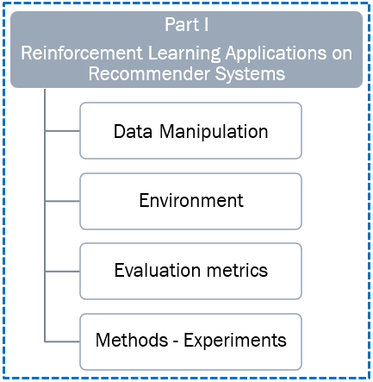
Data
RecSys Challenge 2015 dataset
Dataset is session-based, and each session contains a sequence of clicks
These clicks may have led to purchases or not
For simplicity, we utilize only the clicks sequences
We attempt to give item recommendations appealing enough for the users to click
Original dataset: 9,249,729 sessions and 52,739 items
We reduced the dataset to sessions containing one or more of the top 500 most popular items
We filtered out sessions with less than 4 clicks and with more than 10 clicks
That left us with 693,804 sessions and 500 items

Slide 4
Clustering (I)
Assume that all sessions came from one user
Group the sessions into clusters of similar items
Allows for more personalization
Easier computations - lower dimensionality matrices, but
More complex training process
Simpler training process, but
Would recommend the most popular items to all users
Notes:
Εδώ λέμε τις δύο επιλογές που είχαμε με θετικά και αρνητικά
Και ότι επιλέξαμε το κλάστερινγκ

Slide 5


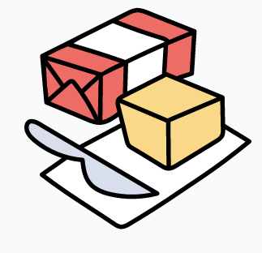
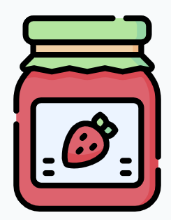


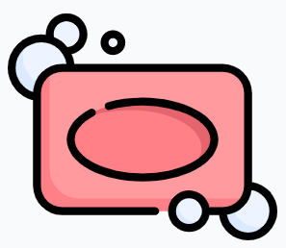


Clustering (ΙΙ)
The objective was to create a grouping of sessions that included items that were frequently bought together
Created a TF-IDF encoding of each session based on both the unigram and bigram existence of items
Managed to encode both the sense of transition as well as the existence of the items themselves inside a session
Cluster #1
Cluster #2
Notes:
Οι εικόνες είναι σχηματική αναπαράσταση των κλάστερ που θέλαμε να φτιάξουμε
Προϊόντα που αγοράζονται συχνά μαζί

Slide 6
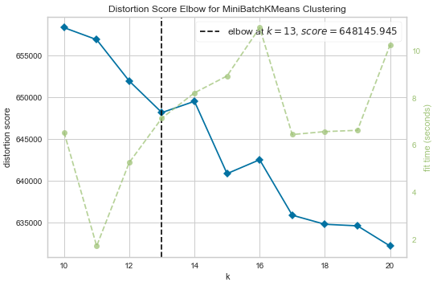
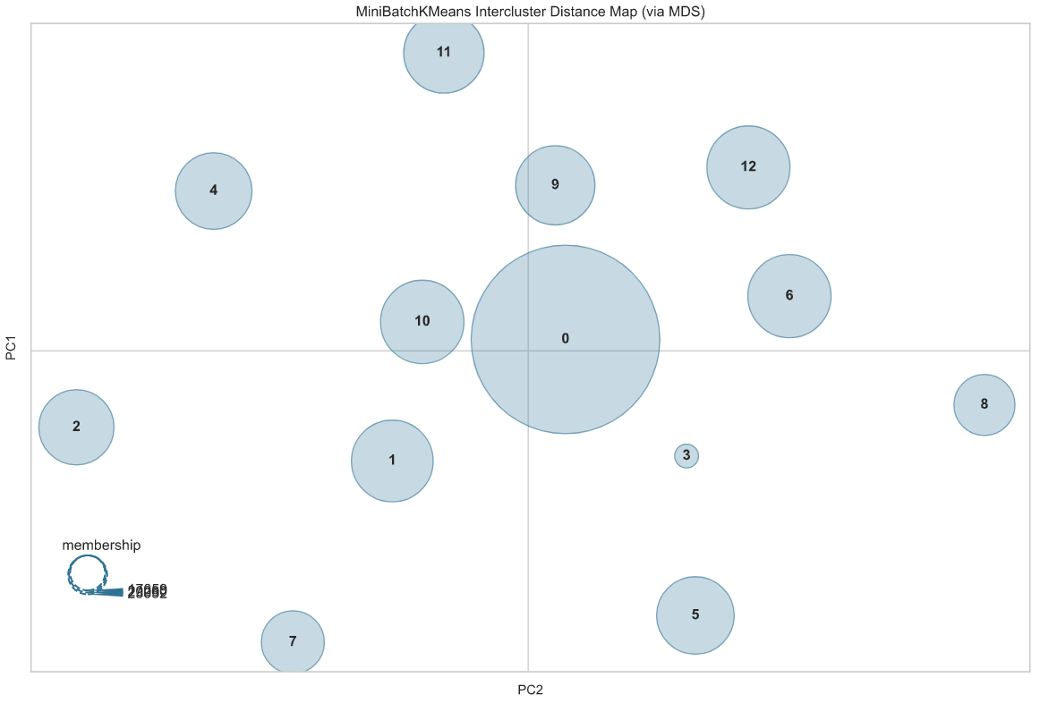
Clustering (ΙΙI)
We run Mini-Batch KMeans and tested for 10 to 20 clusters
The optimal number of clusters came up to be 13
We chose cluster 7 to test our algorithms – the process would be the same for all clusters
We split that to train and test sets (9,777 train – 2,445 test sessions and 295 different items)

Slide 7
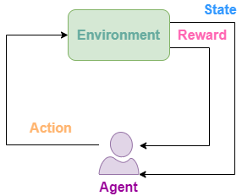
Environment
Environment: The universe of the agent – We created our environment using OpenAI Gym
Agent: The one that makes decisions - clicks
Action: Going from one state to another – Clicking one of 295 items
State: Current item that the agent is visiting – there are 295 possible states – items
Reward: Agent is rewarded with + 1 for correct recommendation, - 1 for incorrect

Slide 8
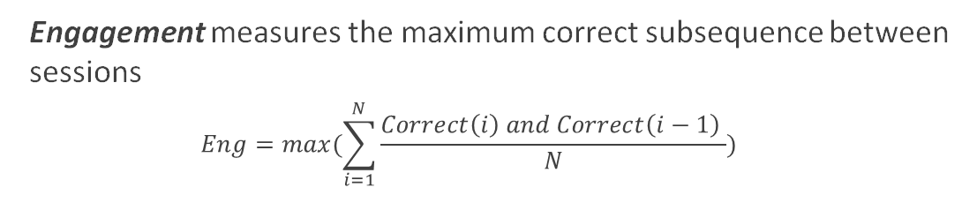
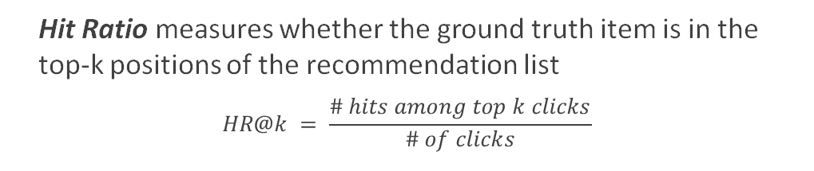
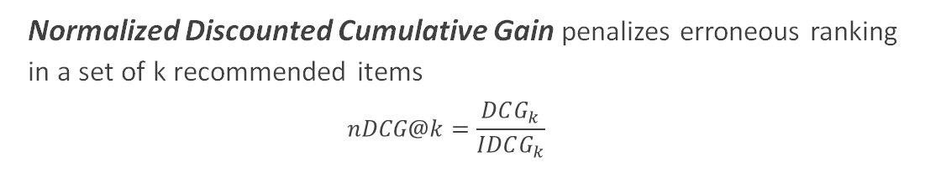
Evaluation Metrics
Hit Ratio measures whether the ground truth item is in the top-k positions of the recommendation list
$$HR@k = \frac{\# hits among top k clicks}{\# of clicks}$$
Our objective is to create a system for next-item recommendations, meaning that given that a user clicked on a certain item we want to recommend a set of items including one that the user will click next
Normalized Discounted Cumulative Gain penalizes erroneous ranking in a set of k recommended items
$$nDCG@k=\frac{DCG_{k}}{IDCG_{k}}$$
Engagement measures the maximum correct subsequence between sessions
$$Eng=max(\sum_{i=1}^{N}{\frac{Correct\left(i\right) and Correct\left(i−1\right) }{N}})$$

Slide 9
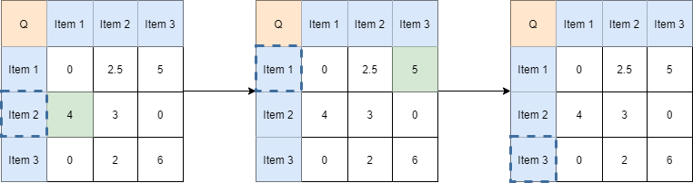

Modeling Q-Learning (I)
Illustrative example of Q-learning algorithm
Model-free reinforcement learning algorithm, based on the state, action, reward model. Instructs an agent on what action to take on a certain state based on rewards. It does not require a model of the environment
In our experiments, we have a 295 x 295 Q table. Given an item-state, the agent dictates a policy that leads to successful recommendations of items.
Q table update rule:

Slide 10
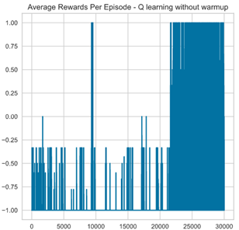
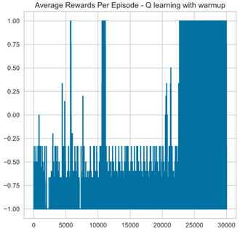
Modeling Q-Learning (II)
Q-Learning without warmup
Q-Learning with warmup
Trained for 30,000 episodes
The whole dataset was used for training
Used 70% of the training set to warm-up the Q table
Q was initialized with bigram frequencies
Used the rest 30% to run Q-Learning algorithm

Slide 11
Modeling Deep SARSA (I)
SARSA algorithm is an on-policy temporal difference (TD) control method. Unlike Q-Learning, SARSA is an on-policy algorithm that uses the action performed by the current policy to learn the Q-value
SARSA
Allows to use a sequence of actions as features
Deep SARSA is an implementation of SARSA algorithm that uses Neural Networks. It does not require external memory (experience replay). We do not need 2 networks for the implementation, as with off-policy methods
DEEP SARSA

Slide 12
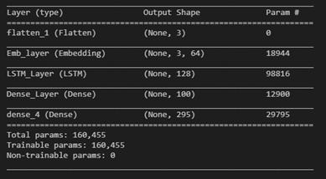
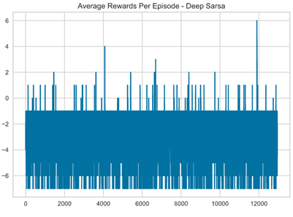
Modeling Deep SARSA (II)
Deep SARSA model
Deep SARSA training
Model input: triplet of historic states
Model output: next item to suggest
SARSA did not seem to perform efficiently given the training horizon

Slide 13

Modeling Deep Q-Learning (I)
Pretraining
To tackle cold-start we pretrained the item embeddings using a next-word prediction task
Deep Q-Learning
We fine tune the pretrained embeddings with our RL task
Experience Replay
For stabilization of performance an external memory is used during training
In Deep Q-Learning, a source and a target clone networks are used in order to emulate the temporal difference in the Q value update rule. Since this implementation alone creates a constantly moving target for our network to optimize, we include an experience replay module to combat this instability

Slide 14
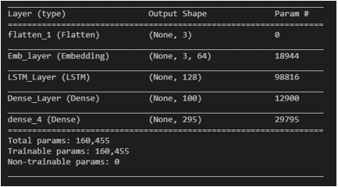
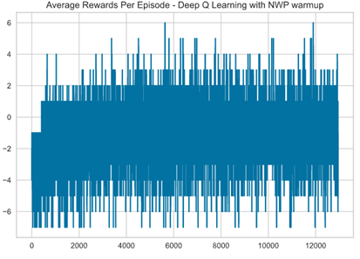
Modeling Deep Q-Learning (II)
Deep Q-Learning model
Deep Q-Learning training
Same as Deep SARSA model
Model input: triplet of historic states
Model output: next item to suggest
Considerably better training results compared to other methods

Slide 15
Modeling Discussion
Q-learning
80 % of the times that we recommend 10 items to the user, the user ends up on clicking one of those items - best score that in all methods for this metric
Deep SARSA:
The worst in all metrics. SARSA learns a near-optimal policy whilst exploring, while Q-Learning directly learns the optimal policy (our goal)
Deep Q-Learning:
NDCG@k almost equal to HR@k: when a correct recommendation occurs, is almost always on top of list
Higher Engagement: repeatedly good recommendations
Metric | Q-Learning Exp. 1 | Q-Learning Exp. 2 | Deep SARSA | DQN
HR@5 | 0.06 | 1.72 | 0.10 | 38.24
HR@10 | 80.43 | 80.46 | 9.60 | 42.27
NDCG@5 | 0.04 | 1.08 | 0.05 | 37.92
NDCG@10 | 11.66 | 12.55 | 2.31 | 38.93
Engagement | 0.02 | 0.02 | 0.00 | 0.32
List of top 10 recommendations is always better than list of top 5 recommendations
When a correct recommendation occurs, it is not placed on top of the list
Warming-up leads to better recommendations

Slide 16
Overview
Part I
Reinforcement Learning Applications on Recommender Systems
Part II
Federated Learning Applications on Recommender Systems
Data Manipulation
Evaluation metrics
Methods - Experiments
Environment
Data manipulation
Problem statement
Metrics
Federated Avg

Slide 17
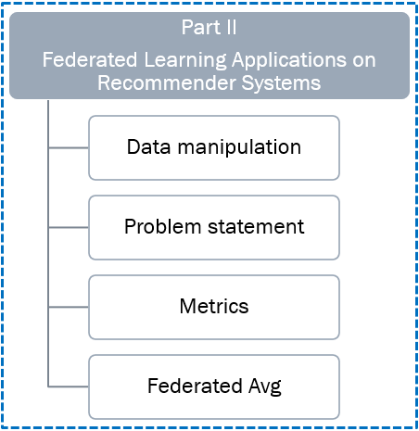
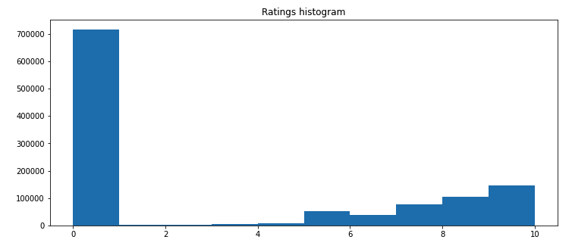
Data
We chose the Book-Crossing dataset
3 tables:
BX-Users: 278,858 users
BX-Books: 271,360 books
BX-Ratings: 1,149,780 ratings in [0-10]
More than half the reviews of our dataset are zeros
Almost no reviews between 1 – 5
Increasing number of reviews from 5 and above
Train test split 70% – 30% (804,846 training – 344,934 testing ratings)

Slide 18
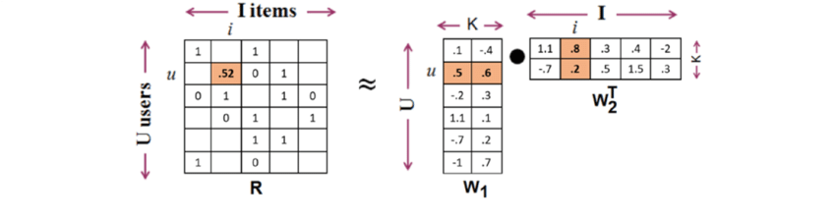

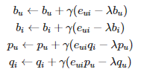

Problem statement
Matrix Factorization: R=P*Q
R: Rating matrix
P: User matrix (m×k)
Q: Item matrix (k×n)
Cost Function:
Minimization of cost function using SGD
Notes:
Αυτός που θα παρουσιάσει μπορεί να πει για το matrix factorization και μετα τι σημαινει το κάθε συμβολο στη συναρτηση κόστους.

Slide 19



Metrics
Rooted Mean Squared Error: standard deviation of residuals
Mean Squared Error: average of the squares of the errors
Accuracy: number of correctly predictions out of all predictions

Slide 20
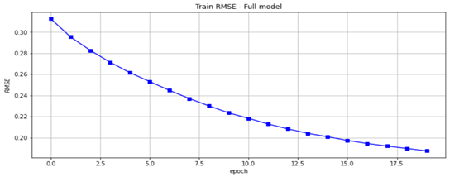
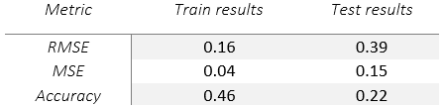
Full Run
Training for 20 epochs
Regularization: 0.01
Learning rate: 1e-1
Latent factors: 4

Slide 21
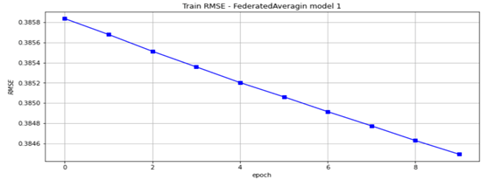
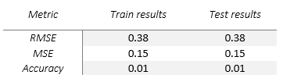
Federated averaging
10 rounds
3 epochs for each user

Slide 22
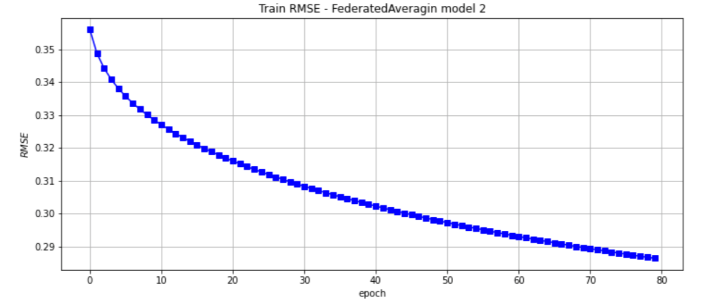
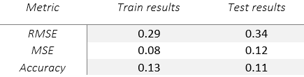
Federated averaging 100 clients
80 rounds
5 epochs for each user

Slide 23
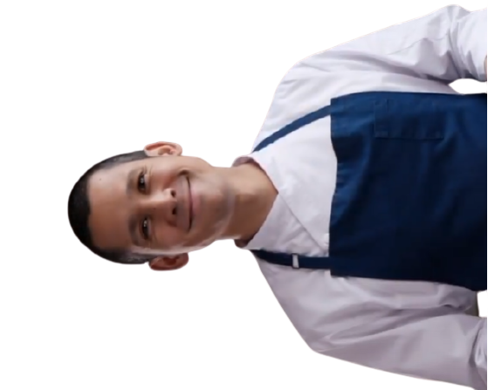

Thank you
Galanos Vasilis
Kyrkos kostas
Mouselinos spyros
Mpaltzi sofia
Saltos thomas

